Slide 1
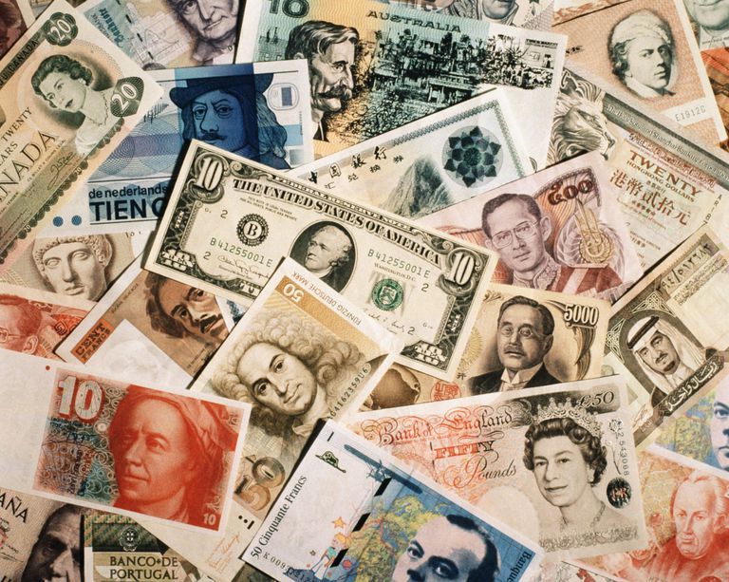
Currency
Money, money, money!!!

Slide 2
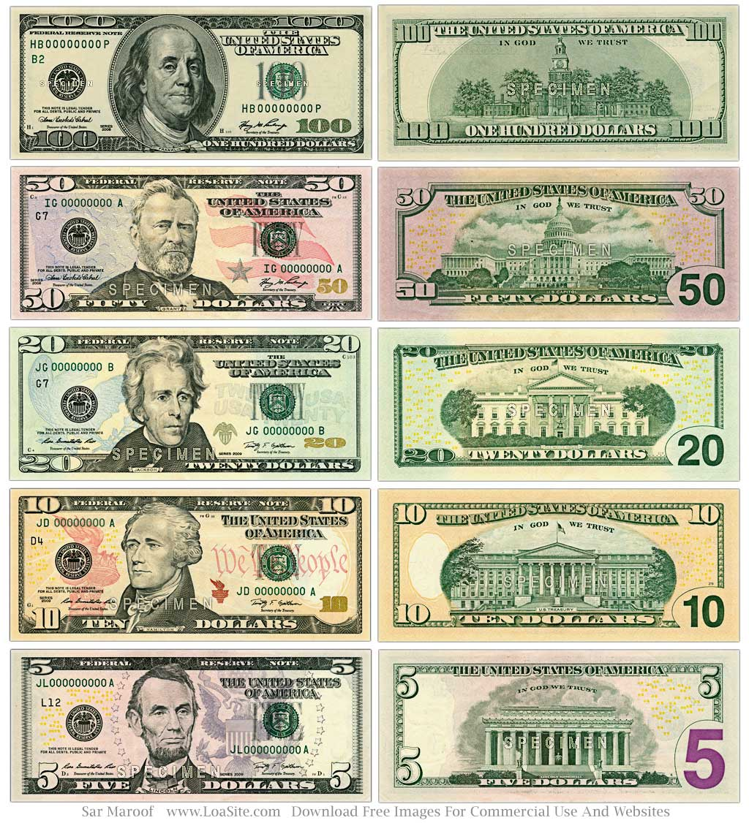
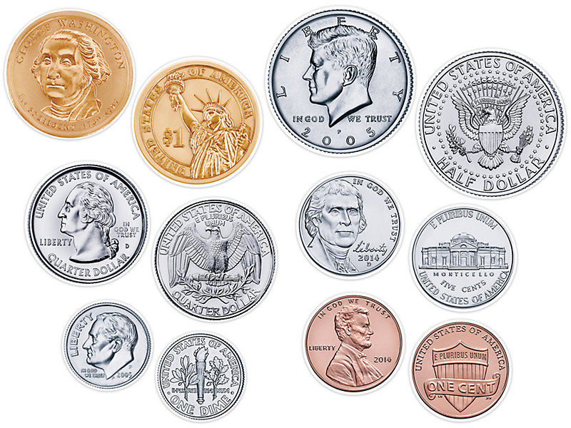
United States of America
Name: dollar
Amounts: $1, $2, $5, $10, $20, $50, $100
Symbols:
Faces of presidents and important people
Animals
Buildings
Monuments

Slide 3
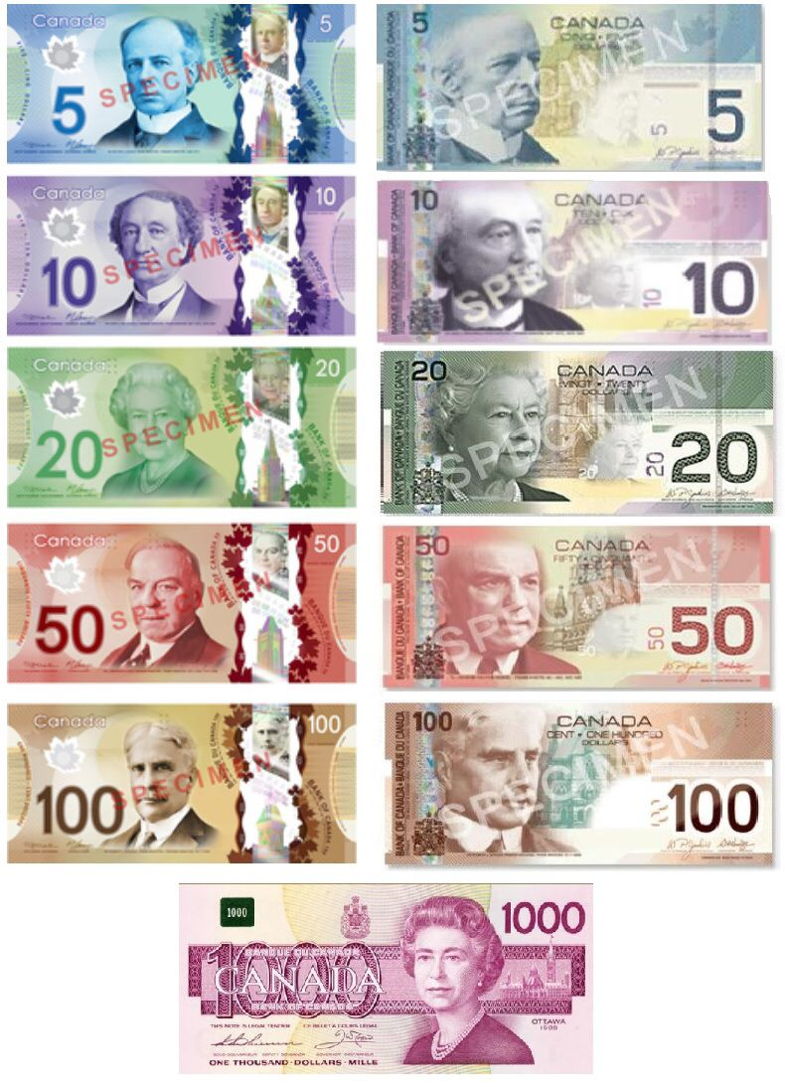
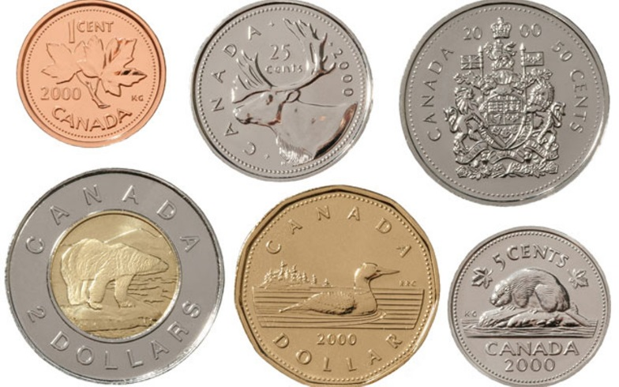
Canada
Name: dollar
Amounts: $5, $10, $20, $50, $100, $1,000
Symbols:
Faces of important people
Buildings
Maple leaves

Slide 4
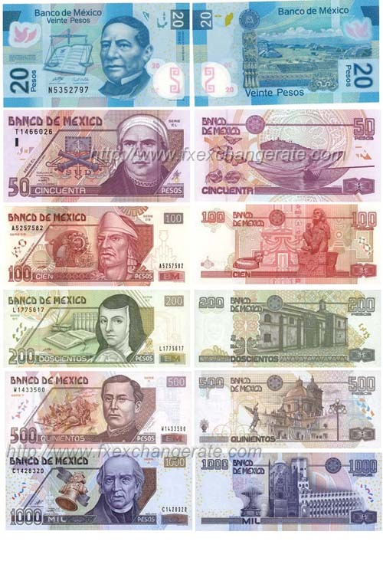
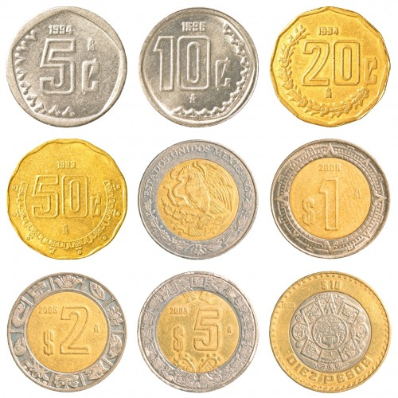
Mexico
Name: peso
Amounts: $20, $50, $100, $200, $1,000
Coins = $1, $2, $5, $10
Symbols:
Faces of important people
Buildings
Maple leaves

Slide 5
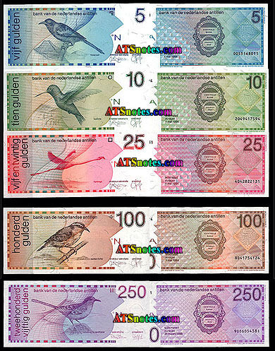
Caribbean
= Owned by European country
Examples: St. Maarten = Netherlands = Florin or Euro
Puerto Rico = U.S.A = dollar

Slide 6
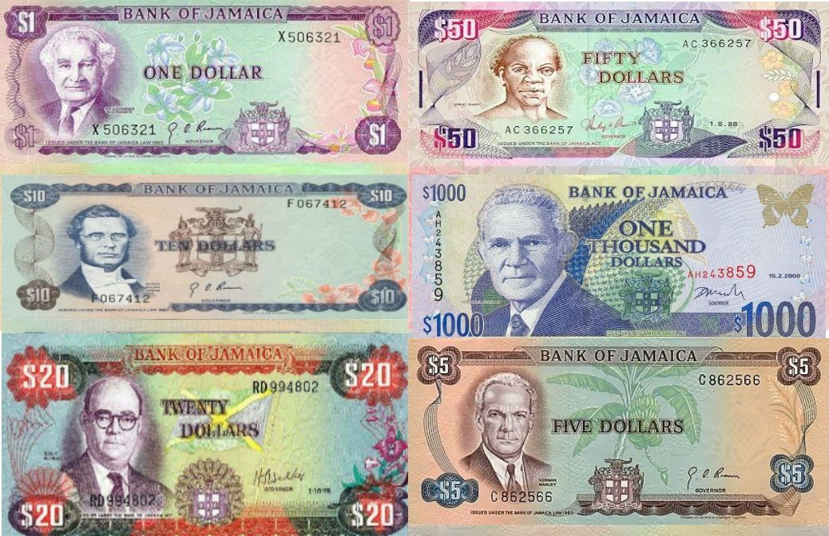
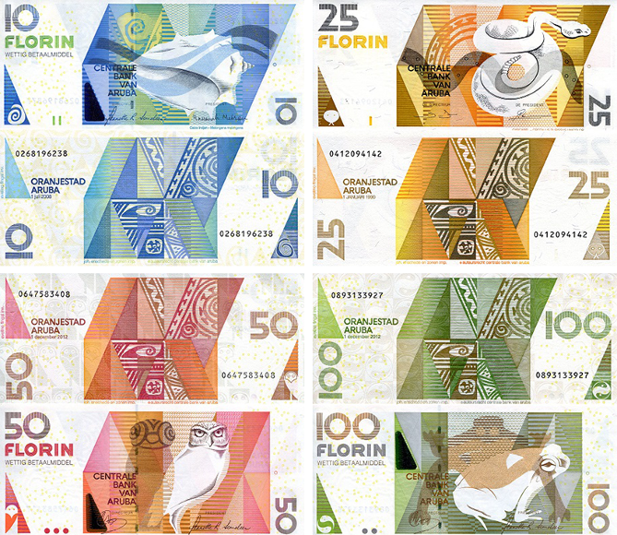
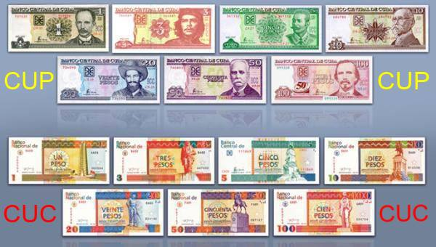
Caribbean
= Have their own currency
Examples: Jamaica = dollar
Cuba = peso, Haiti = gourde, Aruba = florin
CUP = national peso (used by locals)
CUC = convertible peso (used by visitors)

Slide 7
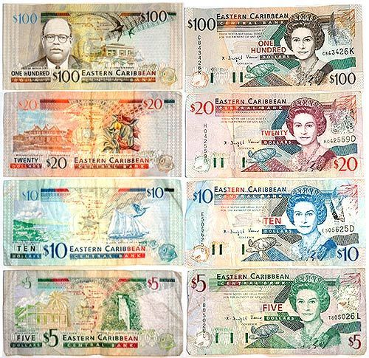
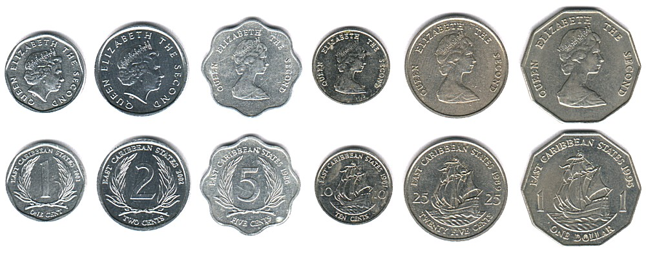
Caribbean
= Eastern Caribbean dollar
All British islands
Examples: Saint Lucia, Grenada, Dominica, Anguilla

Slide 8
Caribbean
Symbols
Faces of important people
Queen Elizabeth
Scenes of history
Nature

